Slide 1
SALES analysis Presentation
Gomolemo Moabalobelo

Slide 2
TABLE OF CONTENT
Introduction 3
Daily and Average unit sales price 4-5
Daily % Gross profit 6
Daily % Gross profit per unit 7
Impact of Promotional Price on January sales performance 8
Price Elasticity of Demand Analysis for Promotional Periods in January 9
Does this product perform better or worse when sold at a promotional price? 10
Conclusion 11

Slide 3
iNTROdution
This sales case study focuses on the daily trading information of a large retail store, aggregated at a daily level. The dataset contains sales activity for only one product.
For the purpose of this analysis, we will concentrate specifically on the months of January and November year 2016, allowing us to uncover trends, compare performance across periods, and identify meaningful patterns in customer purchasing behavior.
By analyzing these two months in detail, we aim to better understand how price, cost, quantity, and promotional activity influence overall performance and profitability for this product.

Slide 4
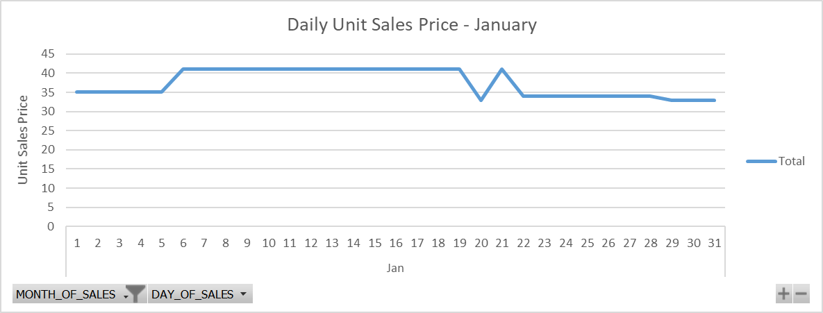
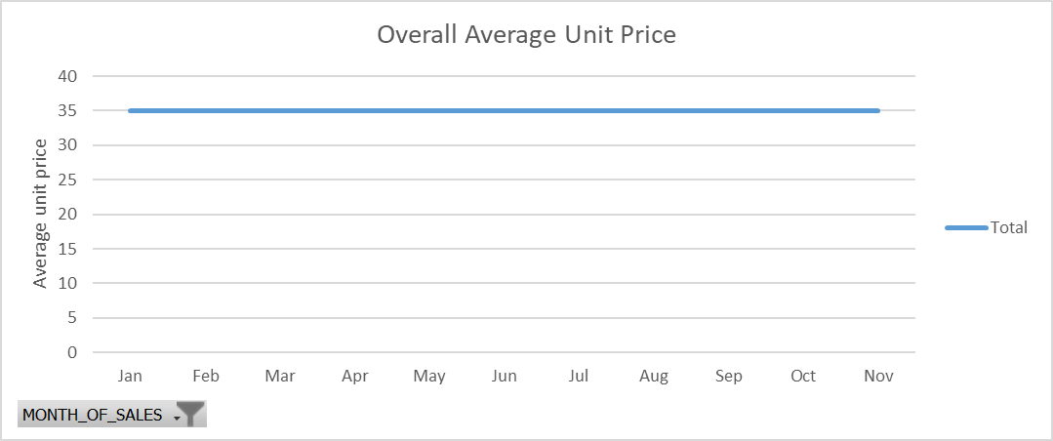
Daily and average unit sales price
The month opened with stability, as the product consistently sold at the normal price from the 1st to the 5th, suggesting typical demand with no pricing intervention.
This was followed by a noticeable shift from the 6th to the 9th, when the price increased to R41, signaling a period of elevated pricing that may point to strategic markups or higher demand conditions.
Midway through the month, on the 20th, the price dropped to R33, placing the product briefly on discount before sharply rising again to R41 on the 21st.
Toward the end of the month, the product moved into a more sustained discount phase, selling at R34 from the 24th to the 28th and decreasing further to R33 from the 29th to the 31st.
This pattern reflects a month that started with normal pricing, experienced targeted increases, and ultimately settled into an extended discounting period.

Slide 5
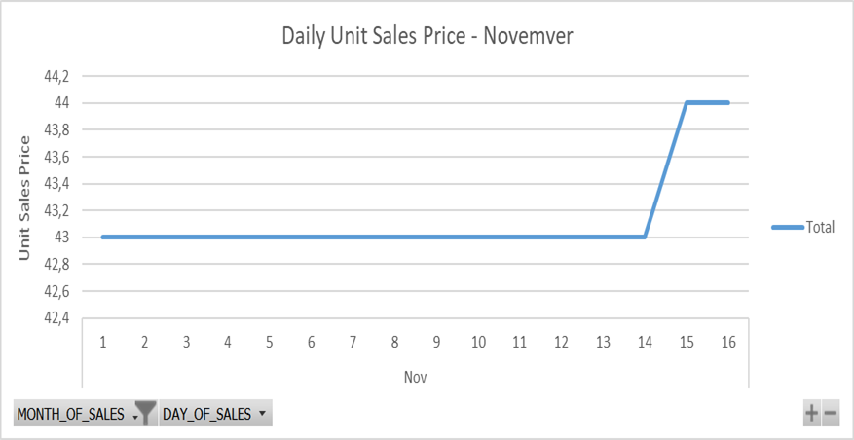

Daily and average unit sales price
In November, the product exhibited a pattern of consistently high pricing throughout the early and middle part of the month.
From the 1st to the 14th, the unit sales price remained steady at R43, reflecting a period of stable demand at a level notably above the normal average, suggesting either strong market positioning.
This consistent pricing was followed by a slight increase on the 15th and 16th, when the unit price rose to R44, indicating a deliberate upward adjustment, possibly in response to demand, inventory considerations, or strategic pricing decisions.
Overall, November demonstrates a month characterized by sustained premium pricing, with only a minor increase occurring in the middle of the month, highlighting a strategy focused on maintaining higher revenue per unit.

Slide 6
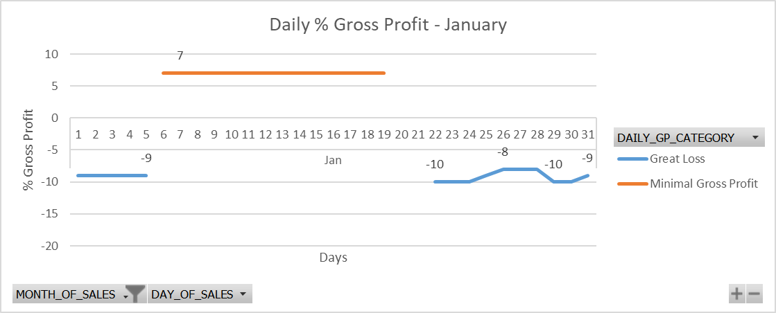
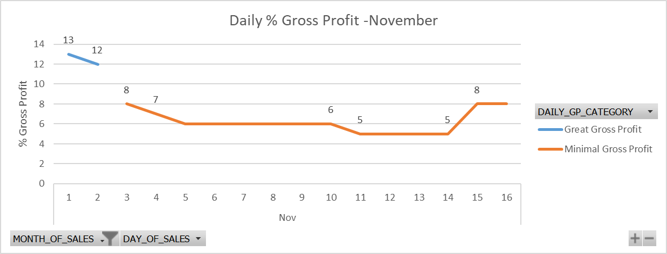
DAILY % GROSS PROFIT
In January, the product’s daily gross profit exhibited significant fluctuations. During the 1st to the 5th, the % gross profit was below zero, indicating that the product was sold at a loss during this period.
From the 6th to the 19th, the daily % gross profit stabilized at 7%, reflecting a period of consistent profitability and effective pricing. However, from the 20th to the 31st, the % gross profit again fell below zero, showing that the product returned to loss-making sales toward the end of the month.
Overall, January displayed a clear cycle of initial losses, a mid-month period of steady profit, and a concluding phase of negative gross profit.
In November, the product’s daily % gross profit began with a slight decline from 13% to 12% in the first two days, followed by a sharper drop to 6% by the 5th. Profitability then stabilized at 6% until the 10th, before dipping slightly to 5%, where it remained steady through the 14th. Mid-month, margins improved, rising to 8% on the 14th and 15th and holding through the 16th.
Overall, November showed early declines, a mid-month period of low but stable profit, and a modest recovery toward the middle of the month.

Slide 7
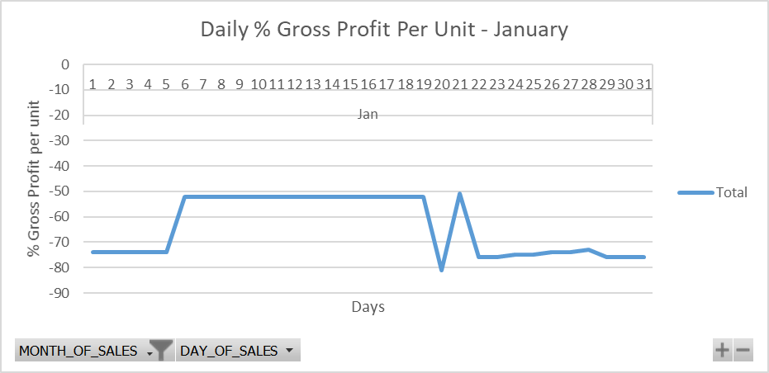
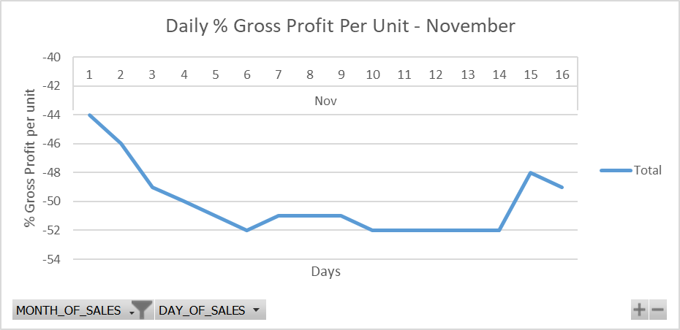
DAILY % GROSS PROFIT PER UNIT
In both January and November, the product’s daily % gross profit per unit remained consistently below zero, indicating that each unit was sold at a loss throughout these months.
In January, despite fluctuations in overall daily % gross profit, the per-unit margins never reached positive territory, suggesting that costs per unit exceeded the sales price on every day.
Similarly, in November, even though overall daily % gross profit showed periods of recovery and moderate profitability, the per-unit gross profit continued to stay negative, highlighting that individual unit sales were still loss-making despite improvements at the aggregate level. This consistent negative performance per unit underscores challenges in covering unit-level costs and the need for pricing or cost adjustments.

Slide 8
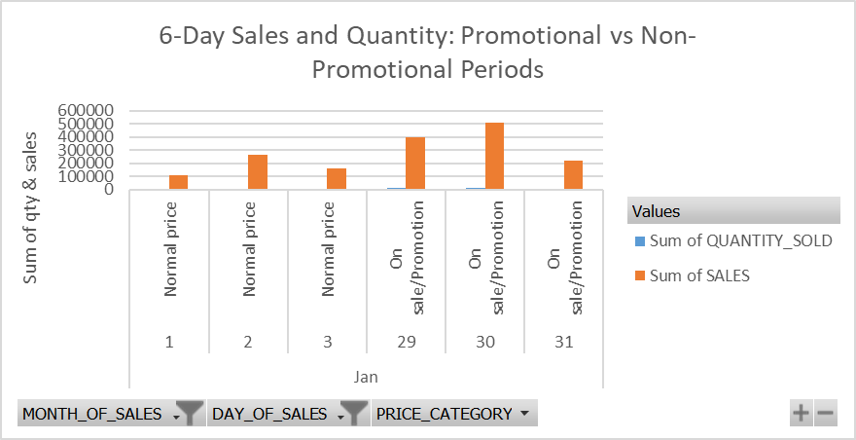
Impact of Promotional Pricing on January Sales Performance
In January, the product showed clear differences between non-promotional and promotional days.
On non-promotional days, sales were moderate, with 3,179 to 7,479 units sold at around R35 per unit, generating daily sales of R111,650 to R262,421.
Promotional days, however, drove dramatic increases in demand: 11,900 to 15,345 units were sold at discounted prices (~R33–R34), yielding sales up to R512,603.
This demonstrates that promotions significantly boost sales volume, highlighting the product’s high price sensitivity and the effectiveness of discounts in driving customer purchases.

Slide 9
Price Elasticity of Demand Analysis for Promotional Periods in January
Promotional Days | Unit Price | Quantity | % Change in price | % Change in Qty | PED | PED Category
29th Jan | 33 | 11900 | (33.4 – 35.1) ÷ 35.1 × 100 ≈ -4.85% | (11,900 – 3,179) ÷ 3,179 × 100 ≈ 274.6% | 274.6 ÷ -4.85 ≈ -56.6 | Highly Elastic
30th Jan | 33 | 15345 | (33.4 – 35.1) ÷ 35.1 × 100 ≈ -4.85% | (15,345 – 3,179) ÷ 3,179 × 100 ≈ 382.2% | 382.2 ÷ -4.85 ≈ -78.8 | Highly Elastic
31st Jan | 33 | 6525 | (33.4 – 35.1) ÷ 35.1 × 100 ≈ -4.85% | (6525– 3,179) ÷ 3,179 × 100 ≈95.8% | 95.8÷ -4.85 −19.76 | extremely high elasticity
Reference of non-promotional day is 1 Jan, with the unit price of 35 and quantity of 3179 sold

Slide 10
Does this product perform better or worse when sold at a promotional price?
Based on the PED calculations, the product is highly elastic during promotional periods. On 29 Jan (PED ≈ −56.6) and 30 Jan (PED ≈ −78.8), small price reductions of ~4.85% led to massive increases in quantity sold (274.6% and 382.2%, respectively). On 31 Jan, PED ≈ −19.76, with a 95.8% increase in quantity. These results show that the product performs much better when sold at a promotional price, as discounts drive substantial increases in sales volume.

Slide 11
conclusion
The product is highly sensitive to price changes. In January, promotional prices (~R33–R34) led to large increases in quantity sold compared to normal prices (~R35), as shown by very high PED values (−56.6 to −19.8). Non-promotional days had moderate sales and mixed gross profit, sometimes negative per day. In November, higher prices (R43–R44) produced stable overall profit, but the daily profit per unit remained negative, indicating that unit costs were higher than selling prices. Overall, promotions strongly boost sales volume, making discounts an effective strategy, though careful monitoring of per-unit profitability is needed to maintain sustainable earnings.

Slide 12

Thank You
gmoabalobelo@gmail.com
https://www.linkedin.com/in/gomolemo-moabalobelo

